Slide 1
New York City
The City that never sleeps

Slide 2
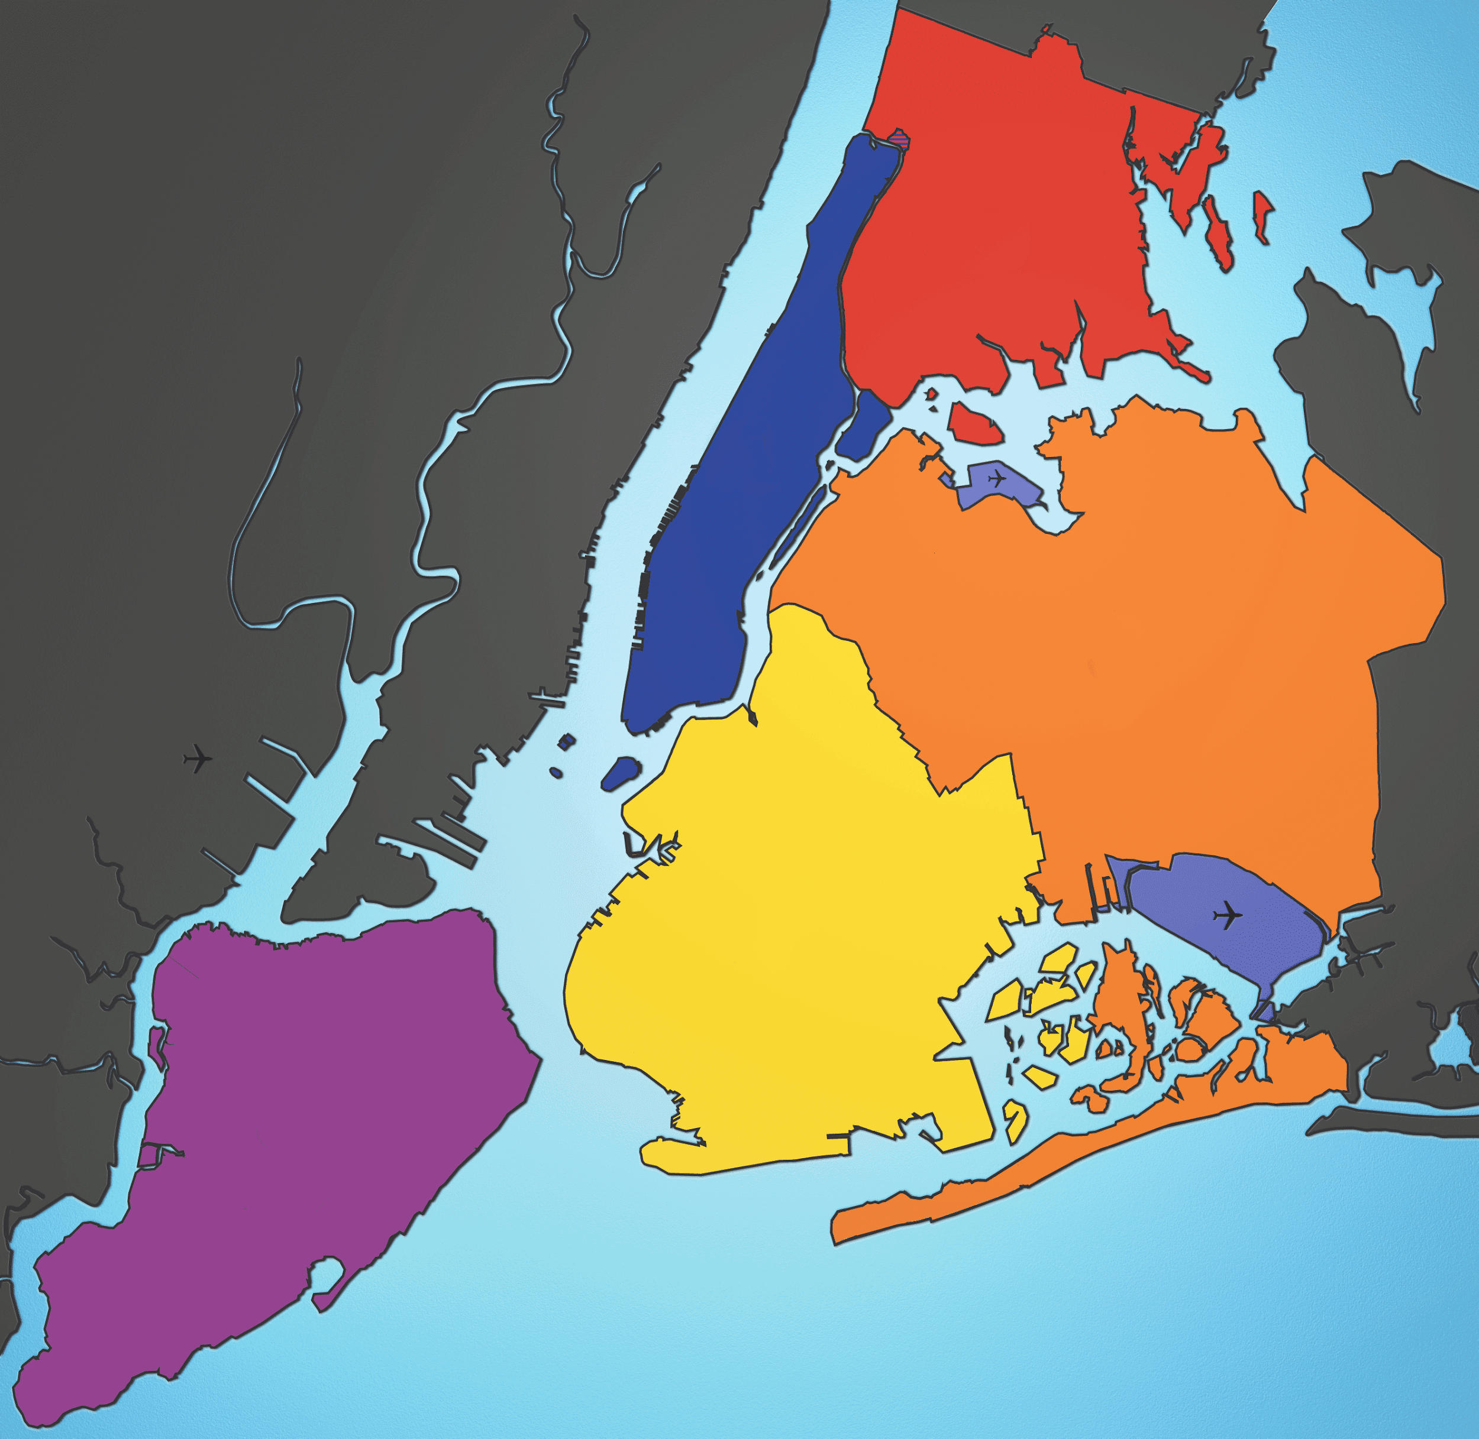
Map of the NYC

Slide 3
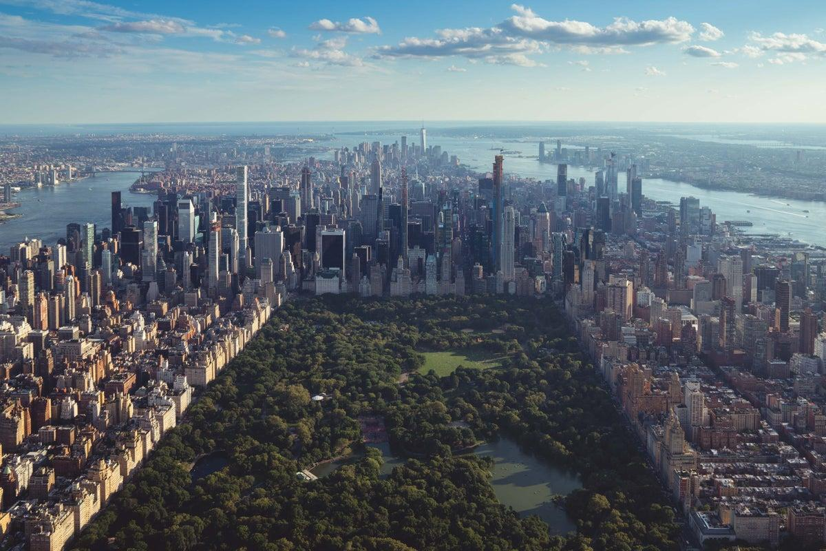
Manhattan-the city centre

Slide 4
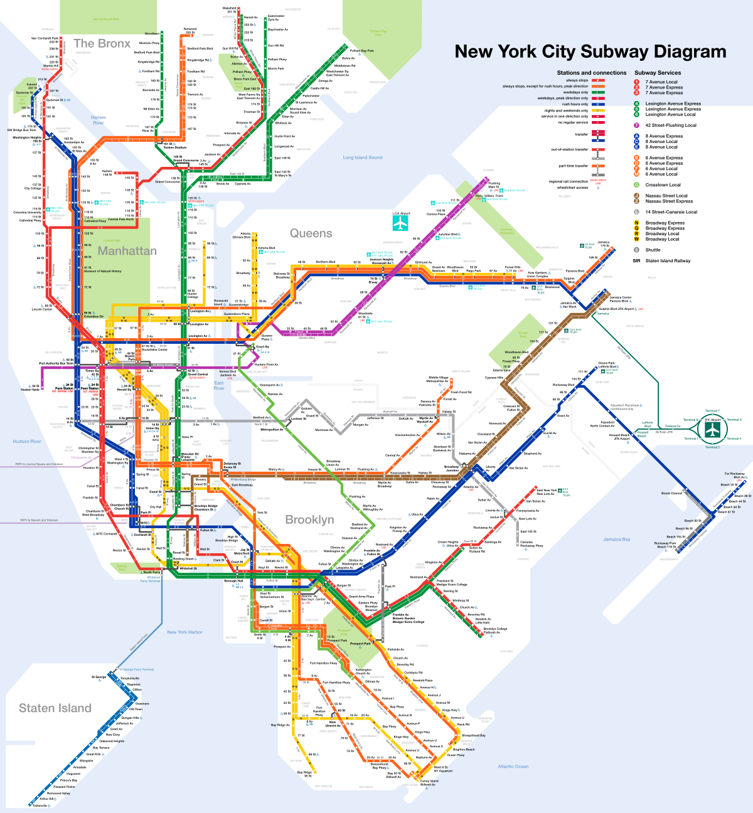
Subway- the best way to commute
NYC’s subway system
has almost 500 different stations

Slide 5
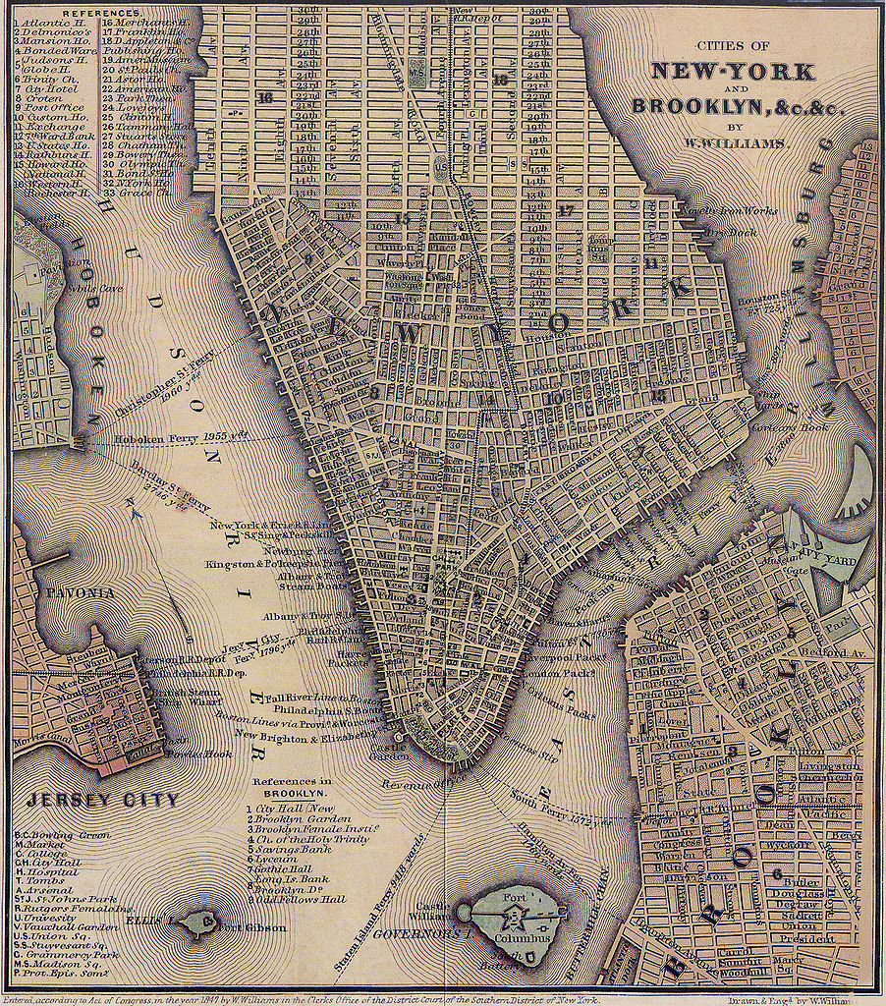
The Dutch and New Amsterdam
New York was founded in 1624
by the dutch, its original name was New Amsterdam.
In 1664 the English took over the city, as it was in a great location, and renamed it to well known New York.

Slide 6
Thank You for Your attention

